Slide 1

Data Visualization
&
Machine Learning Techniques
Muhammad Yasir Rafiq
PhD (Management Sciences)
Liaoning Technical University, China
yasir.mrktg@gmail.com

Slide 2
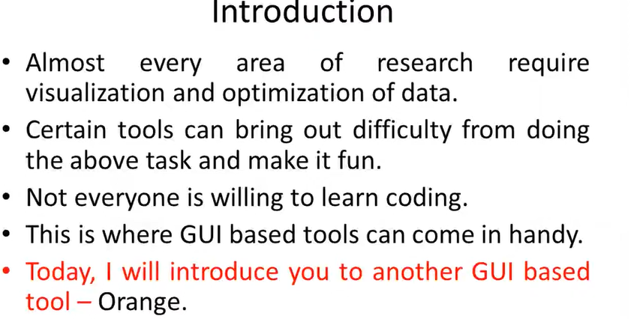

Slide 3
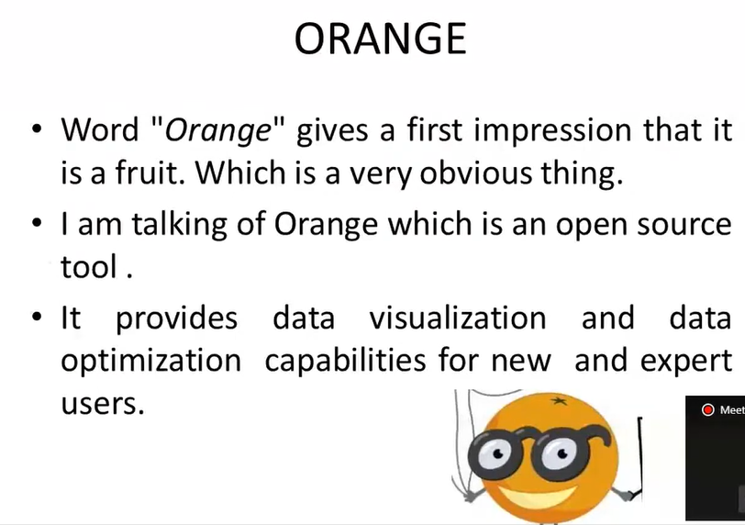

Slide 4
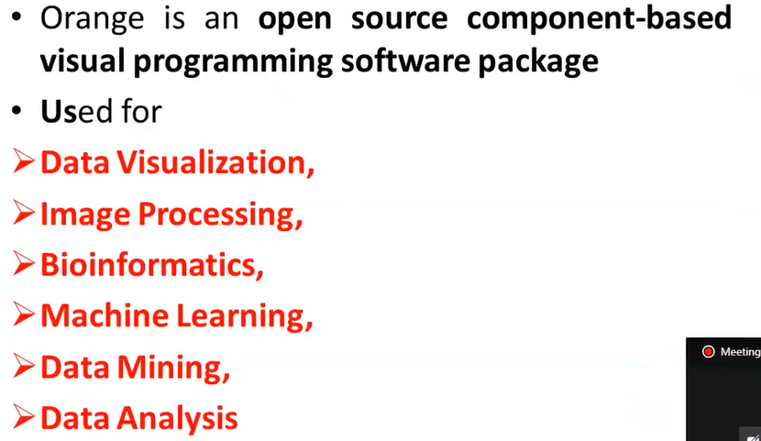
What is Orange???
Components of the Orange are called Widgets.

Slide 5
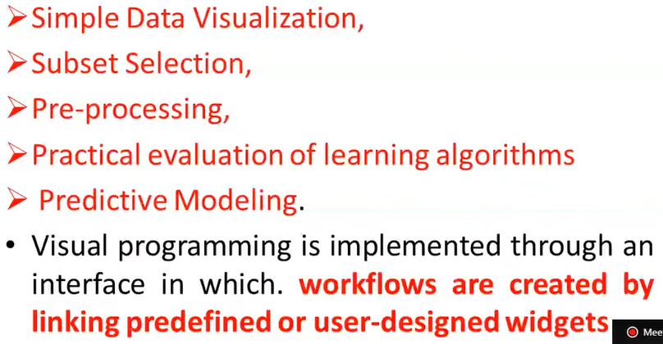
Widgets Range from:

Slide 6
Open Source
Best Part of Orange
This tool is undoubtedly boon for the people doing M.S. / M.Phil. / Ph.D. In most of areas of Management Sciences , Information Technology or Computer Sciences.
One may modify the algorithm as per your application and then may add that modified algorithm in “ Orange” and take the results.

Slide 7
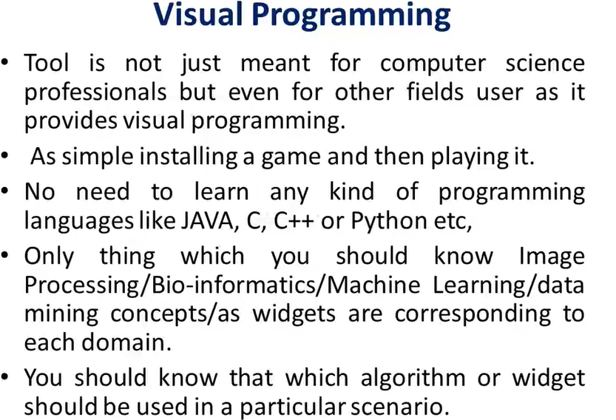

Slide 8
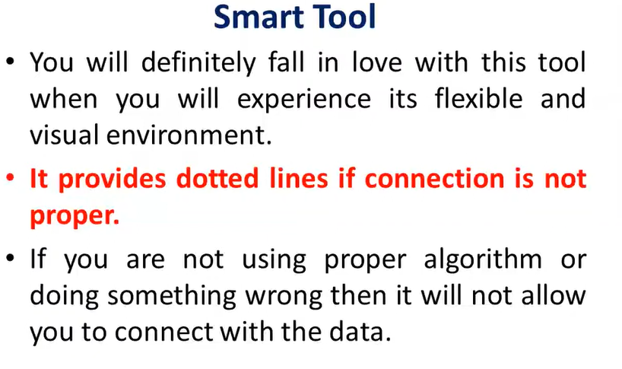

Slide 9
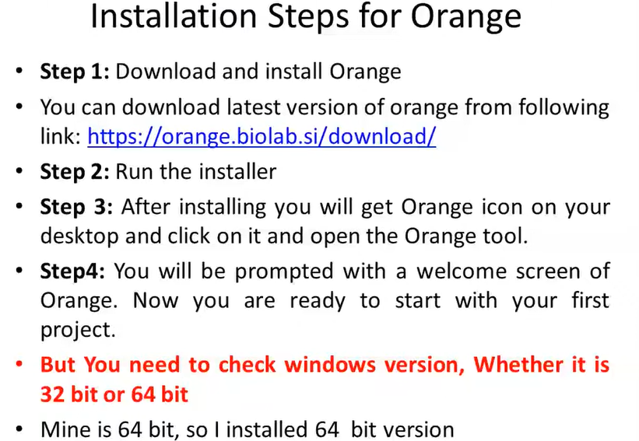

Slide 10
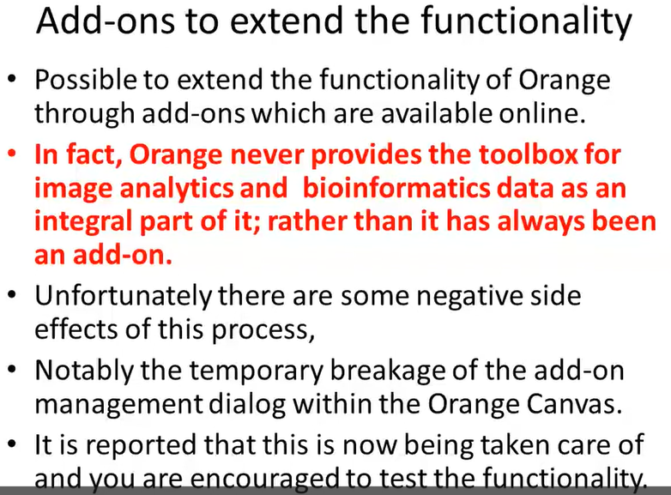

Slide 11
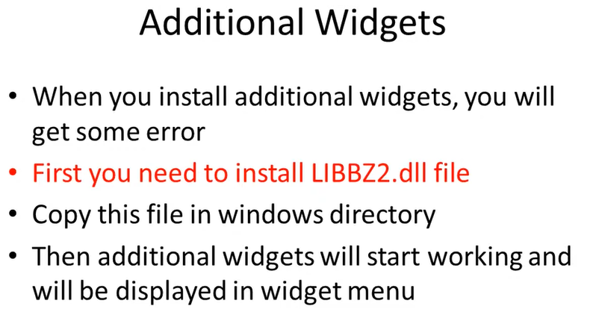

Slide 12
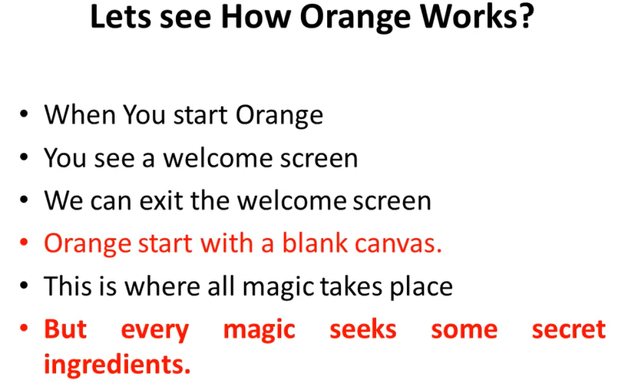

Slide 13
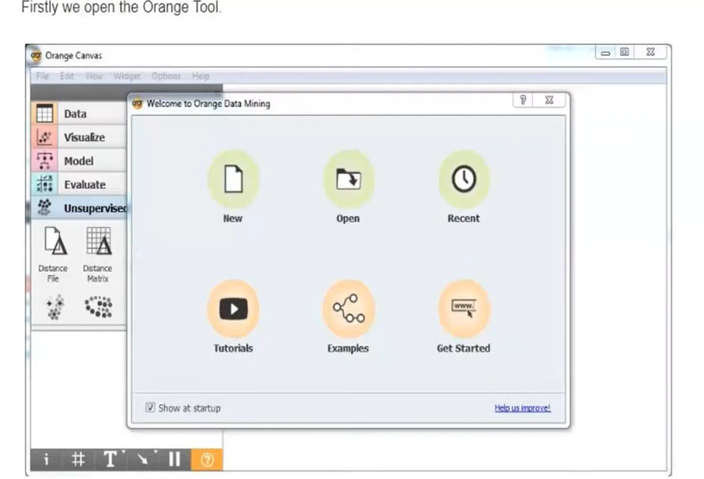

Slide 14
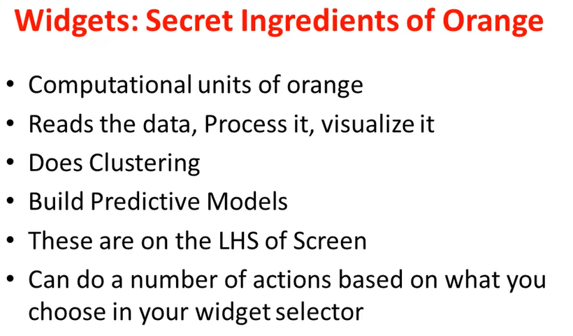

Slide 15
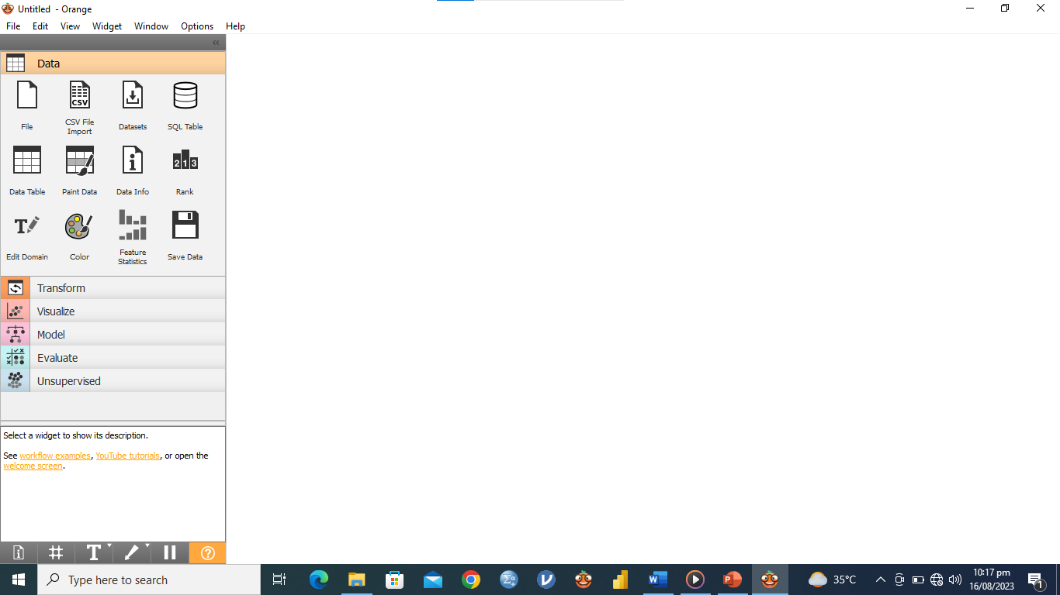

Slide 16
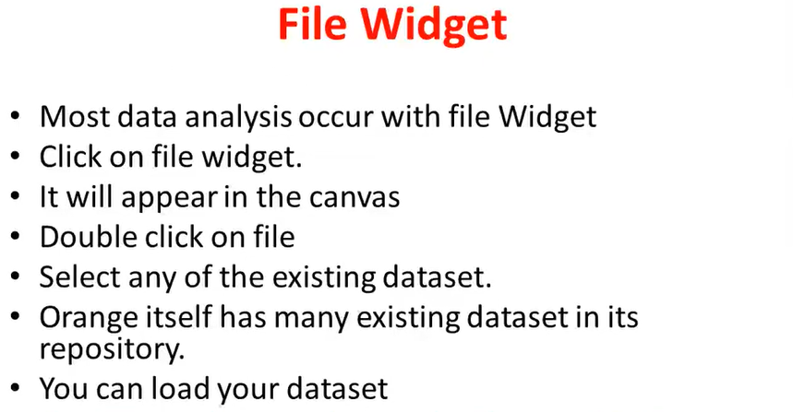

Slide 17
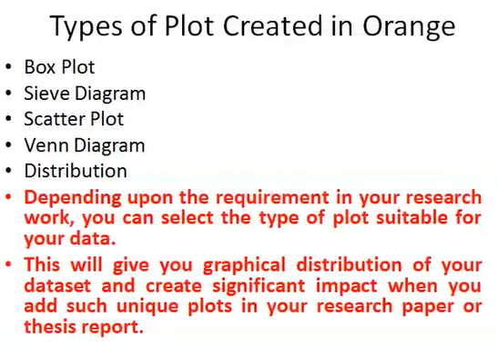

Slide 18
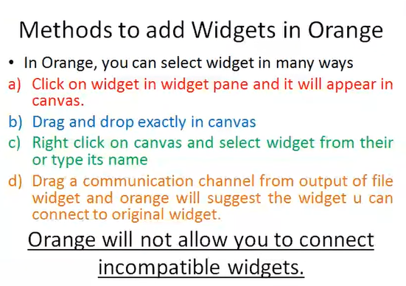

Slide 19
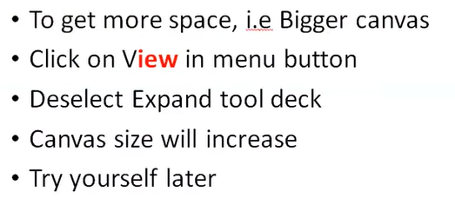
More Space…

Slide 20
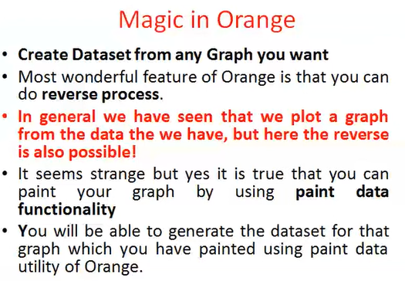

Slide 21
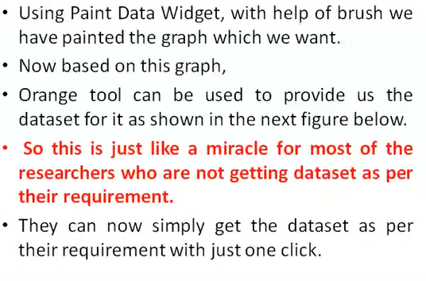

Slide 22
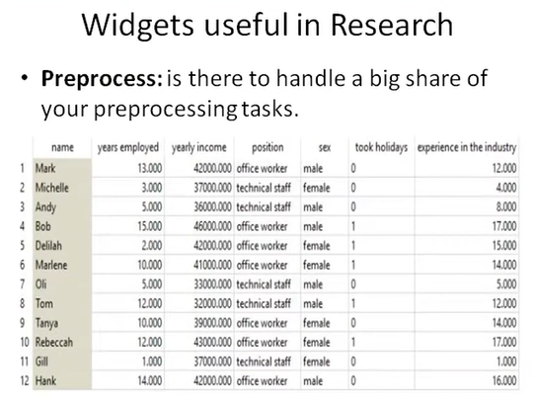

Slide 23
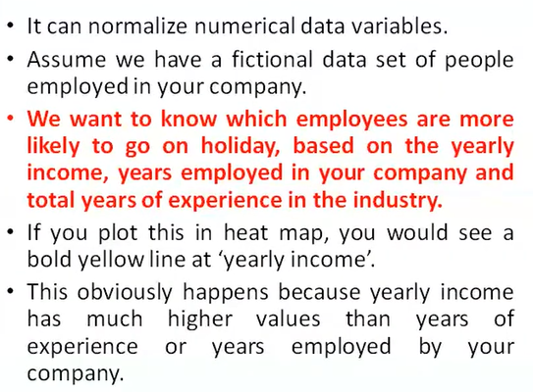

Slide 24
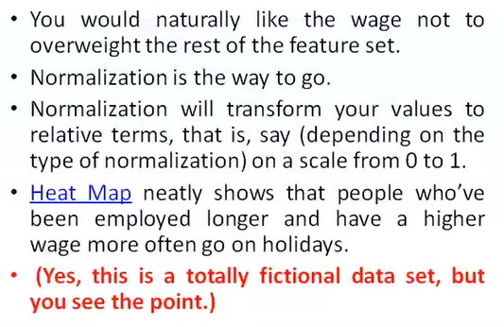

Slide 25
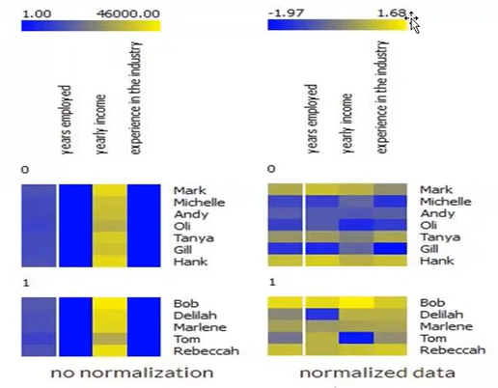

Slide 26
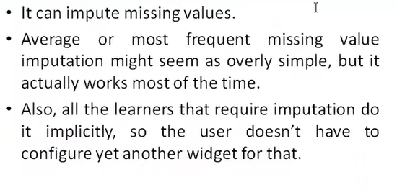

Slide 27
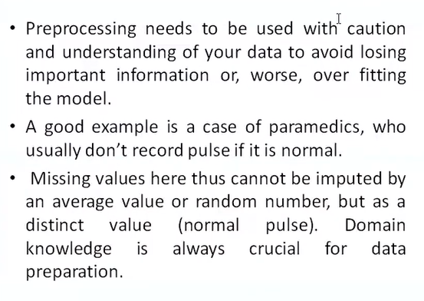

Slide 28
Data Visualization

Slide 29
Car Dataset
Miles_per_Gallon
Cylinders
Origin
Weight_in_lbs
Displacement
Acceleration
Name
Year
Horsepower

Slide 30
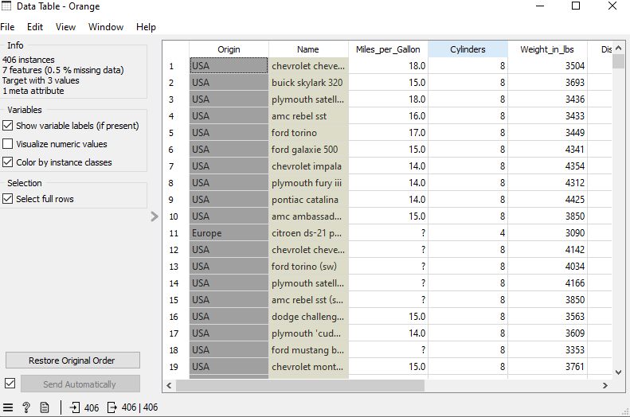
View of Car Dataset in Orange

Slide 31
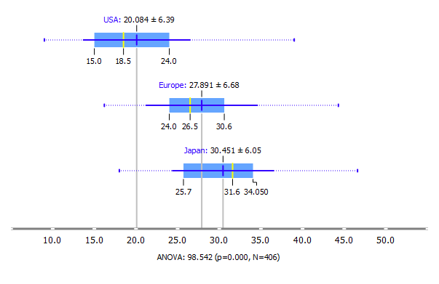
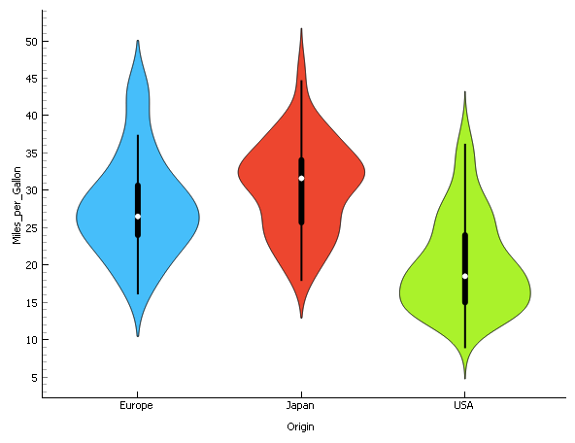
Box-Plot and Villon Chart (Miles Per Gallon)

Slide 32
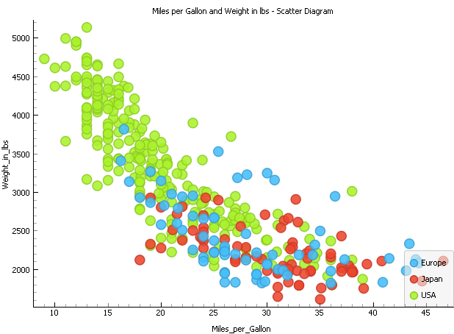
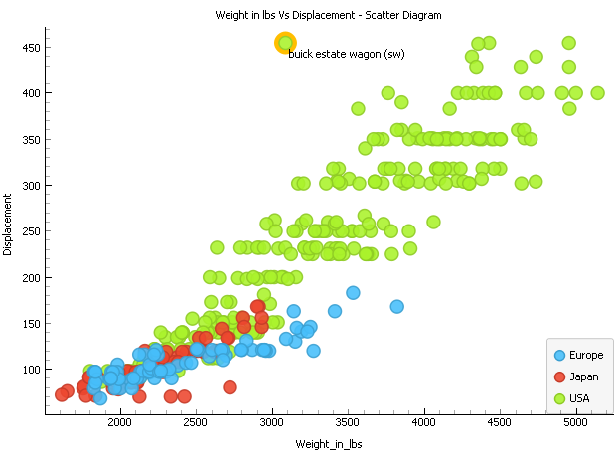
Scatter Diagram

Slide 33
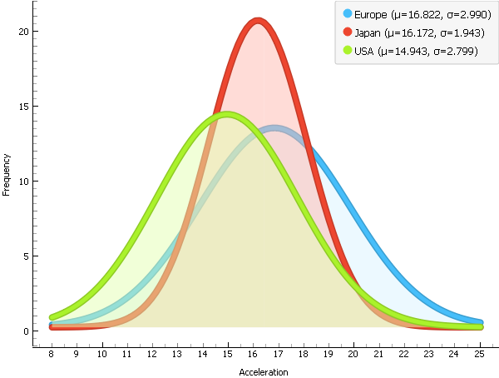
Distributions / Bar Chart

Slide 34
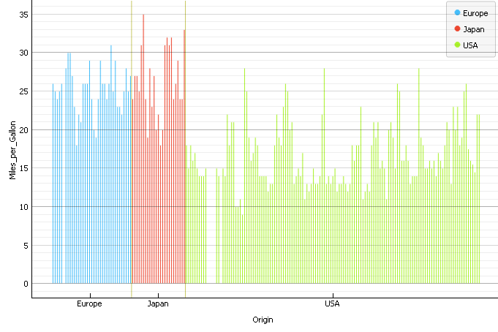
Bar Chart

Slide 35
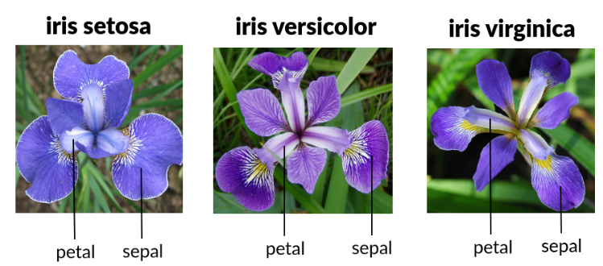
IRIS DATSET

Slide 36
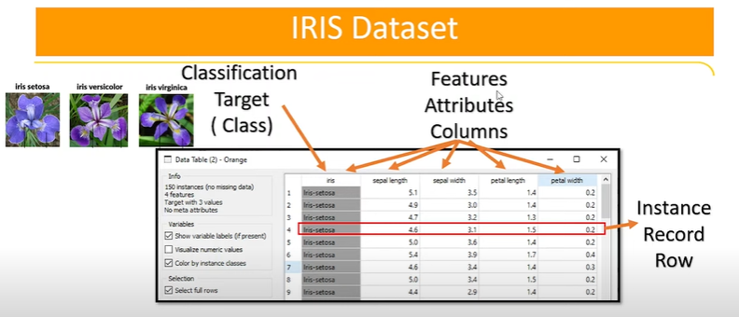
IRIS DATSET-FEATURES

Slide 37
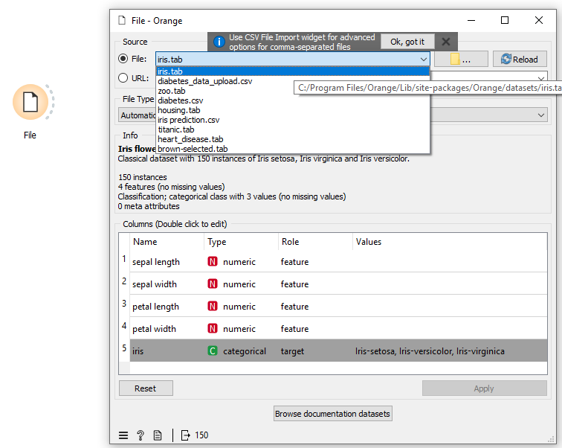
Loading of IRIS Data

Slide 38
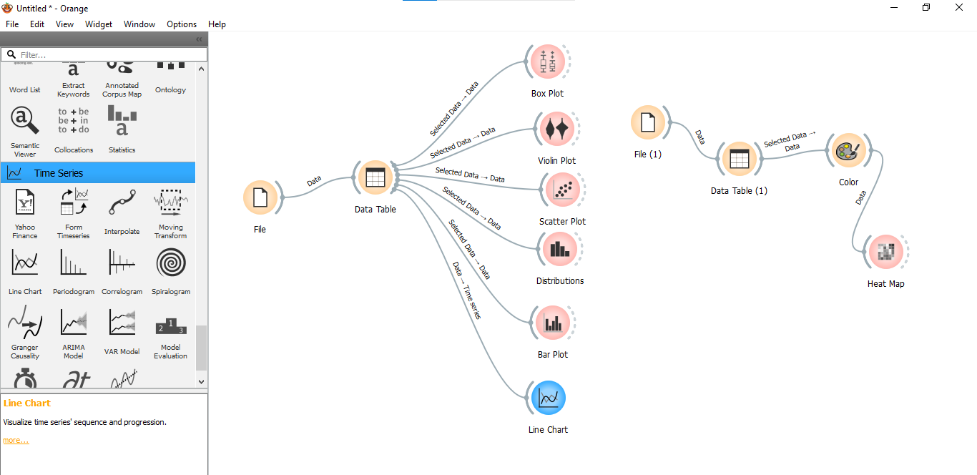
Visualization Using IRIS Dataset

Slide 39
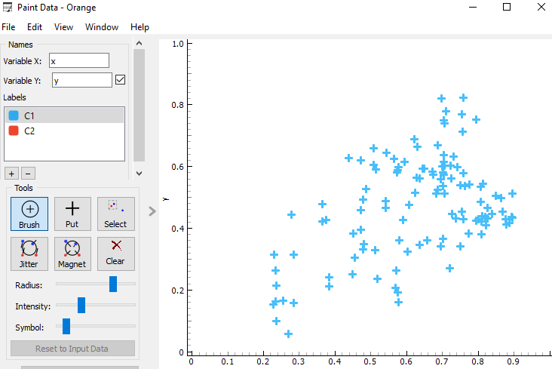
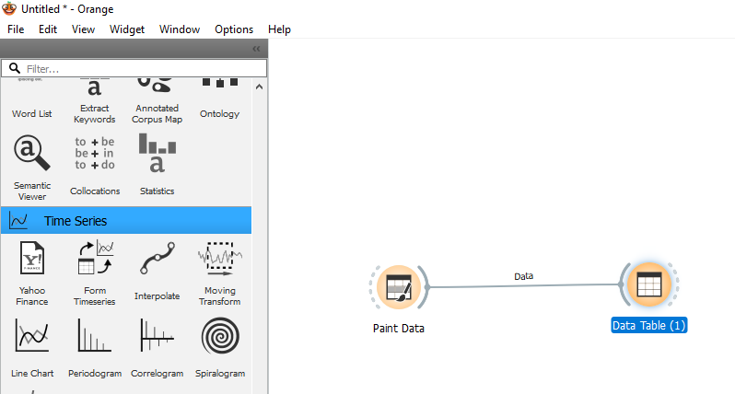
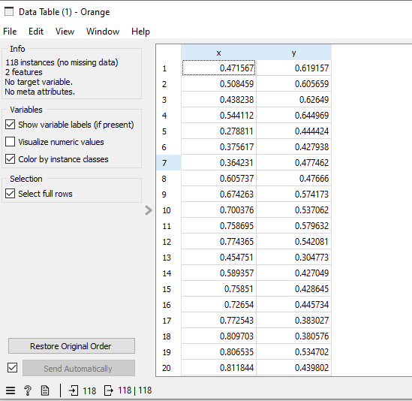
Paint Widget

Slide 40
Data Transformation
Missing Values and Outliers

Slide 41
Data Quality
Examples of Data Quality Problems:
Noise and Outliers
Missing Values
Duplicate Data
Wrong Data

Slide 42
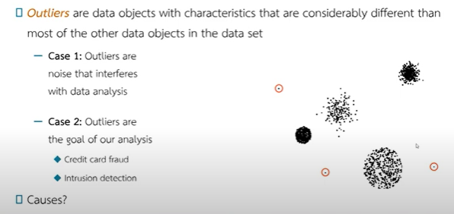
Outliers

Slide 43
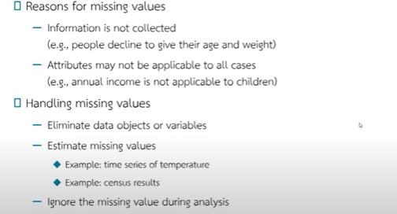
Missing Values

Slide 44
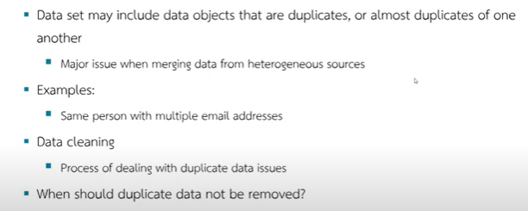
Duplicate Data

Slide 45
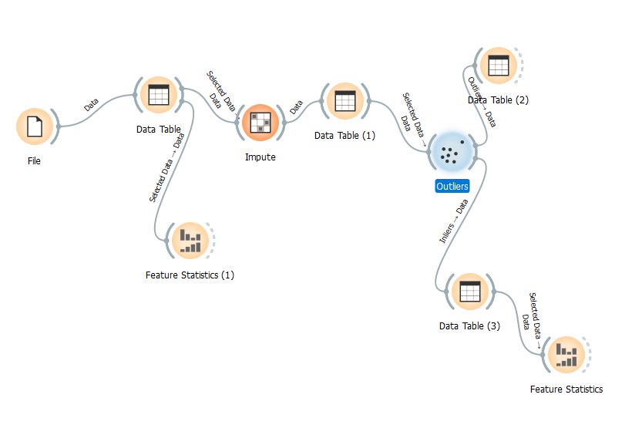
Impute and Outliers

Slide 46
Regression and Evaluation

Slide 47
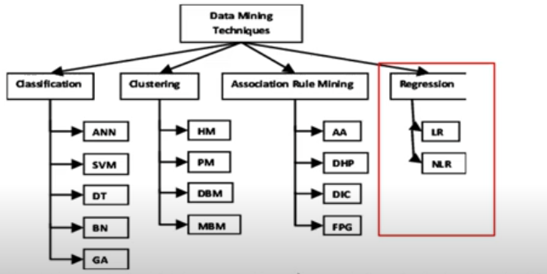
Data Mining Techniques

Slide 48
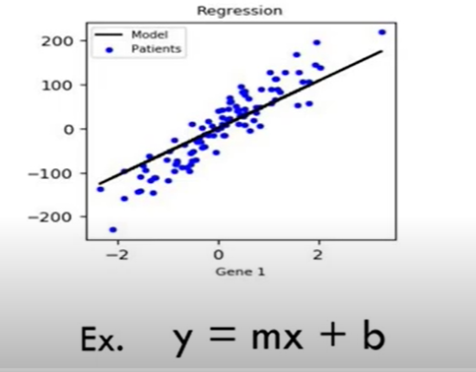
Linear Regression

Slide 49
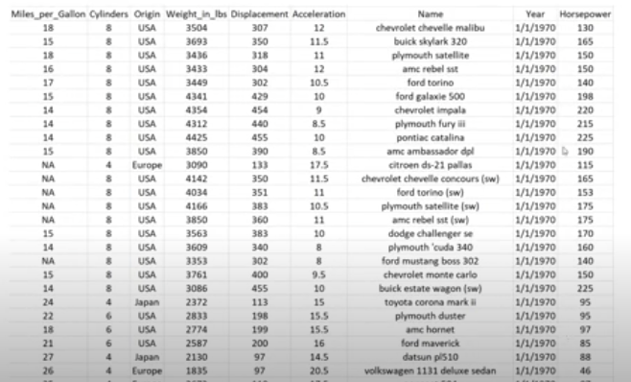
Sample Data

Slide 50
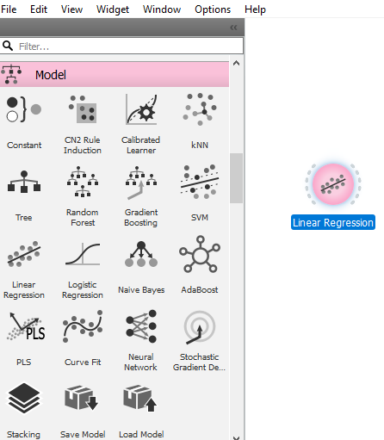
Regression

Slide 51
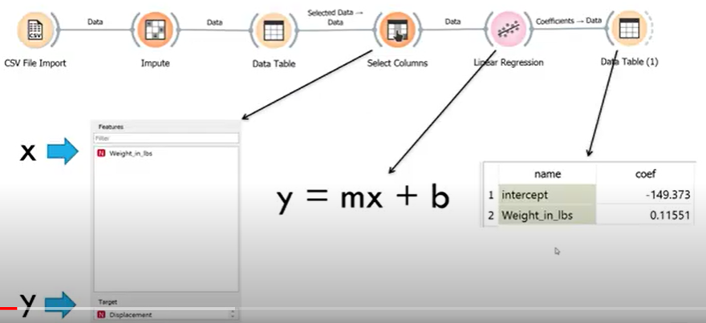
Regression ( Continue…)

Slide 52
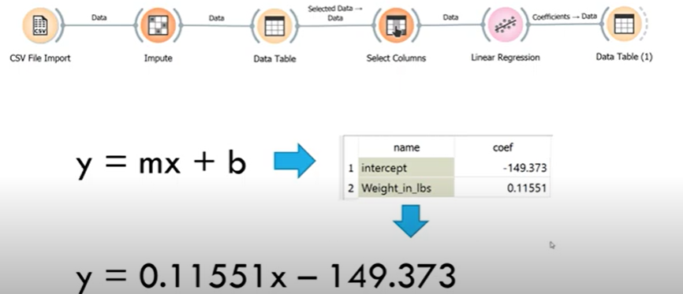
Regression ( Continue…)

Slide 53
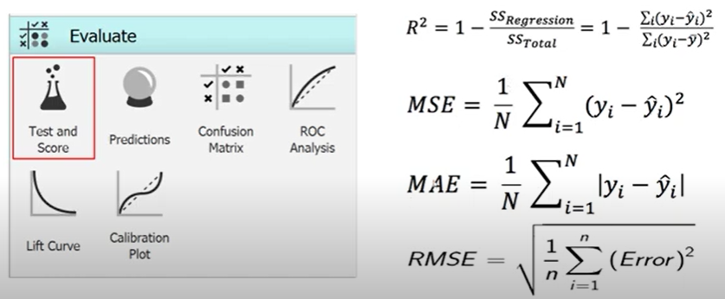
Regression Evaluation

Slide 54

Regression Evaluation

Slide 55

Regression Prediction

Slide 56

Regression Prediction (Continue...)

Slide 57

Complete Analysis

Slide 58
Classification and Evaluation

Slide 59

Data Mining Techniques

Slide 60
Classification
Consider these examples: • Considering whether each loan application poses a risk • Analyzing x-ray images of patients' lungs to detect signs of lung cancer • Analyzing political ideologies based on various factors to determine if someone is centrist, Democrat, or Republican

Slide 61

Learning / Training Data
The process of creating a data classifier from input data sets, each record or data registry to be considered is composed of a set of data features or attributes that indicate the characteristics of individuals. There are also categories or classes that indicate whether the aforementioned credit release is risky or secure. The process of creating a data classifier is often called learning or training.

Slide 62

Decision Tree
The process of constructing a tree for decision-making from categorized data (Supervised Learning)
Want to create a classifier to predict the characteristics of customers who will purchase a computer in an electronics store, with the prediction values consisting of:
"Yes" meaning the customer will buy a computer
"No" meaning the customer will not buy a computer

Slide 63


Decision Tree

Slide 64

K-Fold Cross Validation

Slide 65

Classification

Slide 66

Classification

Slide 67

Classification Evaluation

Slide 68

Classification Evaluation (Continue…)

Slide 69

Classification Prediction

Slide 70

Classification Prediction

Slide 71
Problem Statement
To create a classifier or Model for finding the production source of automobile from the properties of the data we have: Miles Per Gallon, Weight in lbs., Displacement, Acceleration and the horsepower from vehicle’s characteristics data.
Prediction of the country of production of the car.

Slide 72


Decision Tree

Slide 73


Evaluation

Slide 74


Prediction

Slide 75

Comparison ( Decision Tree, Naïve Based, Random Forest, SVM, Neural Network)

Slide 76

Evaluation

Slide 77




Confusion Matrix

Slide 78
On the basis of criteria, Random Forest Technique is considered the best

Slide 79
Machine Learning / Data Mining Techniques
Case Study

Slide 80

Reference Article for Diabetes Prediction

Slide 81

Download DATA

Slide 82

Work Flow

Slide 83


Slide 84


Slide 85


Slide 86


Slide 87

Load and Visualize the Data

Slide 88

Data Preprocessing – Normalization Features

Slide 89

Data Preprocessing – Normalization Features (Continue…Age has been Normalized)

Slide 90

Data Preprocessing –Ranking Feature (Importance of the variables)

Slide 91

Select Column Wdiget- Perform Machine Learning Models

Slide 92

Test and Scores

Slide 93

Demystifying Confusion Matrix _ Predictions_ Diabetes Prediction with Orange Data Mining!

Slide 94


Demystifying Confusion Matrix- For RF & KNN

Slide 95

Predictions

Slide 96

Predictions-Results

Slide 97
Comparisons of Results

Slide 98
Market Basket Analysis

Slide 99

Scenario

Slide 100

1- Support

Slide 101

2- Confidence

Slide 102

3- Coverage

Slide 103

4- Strength

Slide 104

5- Lift

Slide 105

6- Leverage

Slide 106

Summary of Measures

Slide 107
Metrics Explanation in Nutshell:
How do we know these rules are strong rules, how do we know these rules are important, How do i should know, i should these rules seriously important, to answer these questions we have certain metrices which are typically important for market basket of analysis. These matrices are: Support, Confidence, Coverage, Strength, Lift and Leverage. What exactly, these are:
Support: Support is very very important matric here, it reads: 0.18, i.e. 18 %, which means ? Remember that the sample data size in this example is 1000, which means out of 1000 customers 18% of the customers purchase freshmeat, sandwhich, softdrink and dairy milk ( Rule#1). If we consider example of bread and butter how we interpret the support: it is just a ratio, numerator will be , the number of transactions which include both bread and butter and denominator will be total number of transactions. Let 20 be the transactions which include bread and butter, and 1000 will be the total transactions, then support will be 20 /1000. So, higher the value of support we take it seriously and lower the support do not take seriously.
The next important matric is confidence: Confidence is strength of implication of rule. What is the formula of Confidence, let us go back to example of bread and butter, the simple division is easy to do, number of transactions both involved bread and butter, let there are fifty customers who bought bread and butter, 50 will be the numenator divided by number of people wherever they bought bread only.
Let confidence is 0.90 which means that 90% of the people ( Antecedents :...) have going to buy (Consequents).
In simple language Confidence tells us the likelihood of purchasing both the products A & B.
Lift is very important and powerful metric, which helps us to pick up only strong and useful rules. It has threshold values: Less than 1, Equal to 1 and Greater than 1.
Again consider example of bread and butter, if Lift is exactly equal to 1, it means both products are independent. The customer might buy either butter or bread, both will be independent from each other, there is no relationship between them in context of buying. If LIFT is greater than 1, it what which is very very important, and you need to take it very seriously, there is possible correlation between buying bread and butter. The person buying bread having higher possibility of buying butter. We generally focus on the value greater than 1.
However, if the value of Lift is smaller than 1, it means they are negatively correlated. These are the products which don’t sell together. The preference of buying the consequent given that the customer had already buying the Antecedents.
Lift is the measures that help the manager to decide the product placement in the store / shelf.

Slide 108

Example

Slide 109

Details of transactions and products

Slide 110





Slide 111


Frequent Widget
It tells us , how many times the products are appear in the data, For example bread appears 4 times, milk shown 3 times while cereal, eggs and sugar appears 2 times and finally butter appear only 1 time in our dataset.

Slide 112


Rule# 1: Let's break down what these measures mean for the rule: "If a customer buys milk, then they also buy bread," given the following values:
Notes:
Let's break down what these measures mean for the rule: "If a customer buys milk, then they also buy bread," given the following values:
Support: 0.60
Confidence: 1.00
Coverage: 0.60
Strength: 1.33
Lift: 1.25
Leverage: 0.120
1. Support: 0.60
What it is: Support tells us how often the rule applies to the entire dataset.
Meaning: 60% of all transactions include both milk and bread.
Simple Example: If you have 100 transactions, 60 of them include both milk and bread.
2. Confidence: 1.00
What it is: Confidence tells us how often bread is bought when milk is bought.
Meaning: Every time milk is bought, bread is also bought.
Simple Example: If a customer buys milk, they will definitely buy bread.
3. Coverage: 0.60
What it is: Coverage tells us how often milk is bought out of all transactions.
Meaning: 60% of all transactions include milk.
Simple Example: If you have 100 transactions, 60 of them include milk.
4. Strength: 1.33
What it is: Strength compares how often bread is bought to how often milk is bought.
Meaning: Bread is bought 1.33 times as often as milk.
Simple Example: For every 3 transactions that include milk, 4 transactions include bread (approximately).
5. Lift: 1.25
What it is: Lift tells us how much more likely it is to buy bread when milk is bought, compared to buying bread independently.
Meaning: Customers who buy milk are 1.25 times more likely to buy bread compared to the overall likelihood of buying bread.
Simple Example: Buying milk increases the chance of buying bread by 25% compared to buying bread on its own.
6. Leverage: 0.120
What it is: Leverage tells us the extra occurrence of both items (milk and bread) appearing together compared to what we’d expect if they were independent.
Meaning: There’s a 12% higher chance of milk and bread being bought together than if they were bought independently.
Simple Example: If we expect milk and bread to be bought together in 48 transactions (independently), we actually see them bought together in 60 transactions, giving us 12 extra occurrences (0.12).
Summary of What These Measures Mean Together
High Support (0.60): A significant number of transactions (60%) include both milk and bread, making this rule quite common.
Perfect Confidence (1.00): Every time milk is bought, bread is also bought. This means that whenever you see a customer buying milk, you can be 100% sure they will also buy bread.
Coverage (0.60): Milk is bought in 60% of transactions, meaning milk itself is a common item.
Strength (1.33): Bread is bought more frequently than milk, indicating a higher overall demand for bread.
Lift (1.25): The likelihood of buying bread increases by 25% when milk is bought, indicating a positive association between buying milk and bread.
Leverage (0.120): There is a 12% higher chance of milk and bread being bought together than would be expected if their purchases were independent, showing a strong co-occurrence.
Overall, these measures indicate a very strong association between buying milk and bread. Milk is a common item in transactions, and whenever it's bought, bread is always bought too. This could imply a strong habitual purchase pattern, such as customers frequently buying these items together for breakfast.
4o

Slide 113


Rule# 2: If a customer buys cereal, then they also buy bread

Slide 114


Rule# 3:If a customer buys milk and cereal, then they also buy bread.

Slide 115


Rule# 4: If a customer buys both milk and sugar, they will always buy both bread and eggs as well.

Slide 116
Time Series Analysis

Slide 117




Slide 118

Examples of Time Series

Slide 119
Difference between ARIMA & VAR MODELS
ARIMA | VAR
Auto-Regressive Integrated Moving Average | Vector Auto Regressive
Univariate Time Series | Multivariate Time Series
Uni-Directional Model: The dependent variables are influenced by their Past or Lag values itself | BI-Variate Model: A dependent variable is affected by past value or any other variable’s value OR influenced by both

Slide 120
How to Perform Time Series Analysis
Note: First we need to add Time Series Tab using Ads-On Option.
File: Employement. Csv file will be used to perform ARIMA. This file contains information about “Years” (1980-2020) and “Employment Rate” with respect to each year.
Since, Year column is showing a sequence, therefore we consider it as Meta while performing ARIMA.

Slide 121



Performance of ARIMA in Orange File: Employment

Slide 122

ARIMA Model
Note:
1- In file Widget, we have to define Employment Rate as Target, while Year as Meta, it must be of Datetype.
2- We may get different values by considering different values of parameters like: p, d, q.
3- Forecast Steps ahead option is used to predict the next desired values.

Slide 123


Predicated Values

Slide 124


Line Chart For the Predicated Values

Slide 125

Model Evaluation
Workflow:
Note:
No. of folds must be 10.

Slide 126

Model Evaluation

Slide 127



Example-2 File: Daily Temperature

Slide 128



Predictions using ARIMA

Slide 129


Evaluation

Slide 130

Graph of Predicted Values

Slide 131

Comparison of Different ARIMA Models: ARIMA (1,0,0)

Slide 132

ARIMA (1,1,0)

Slide 133

ARIMA (1,1,1)

Slide 134
VAR MODELS
(Vector Auto Regression Models)

Slide 135
NOTE:
In this example, we are going to predict the Stock Market, However one can not rely on the predictions of this model as there are other variables than open and close share prices , which may effect the stock market like Political situation, Economic situation, News about peace or war, Health situation and Environmental effects etc. By using this model, we may have close / estimated values to the actual / real values.
We are using Stock Market file to perform VAR Model. In it Close is our target, while remaining all variables are considered as features.

Slide 136

Loading of File
Make sure that:
Select the column with date should be accurate.

Slide 137


Line Chart

Slide 138

Performance of VAR Model

Slide 139


Predicted Values

Slide 140
Text Mining
Text and Corpus

Slide 141
Text & Corpus
Cluster & Classification
Importing Documents
Sentiment Analysis

Slide 142

Corpus

Slide 143


Corpus Viewer

Slide 144

Searching of Keywords (“King”)

Slide 145


Word Cloud Without Pre-Processing
Its useless have no specific interpretation

Slide 146

Pre-Processing

Slide 147


Word Cloud After Pre-Processing
On the left side we have words and their frequencies.

Slide 148


Word Counts and Save in Excel Format

Slide 149
Text Clustering

Slide 150

Uploading of File

Slide 151

Corpus Viewer

Slide 152

Pre-Processing text
Generally we Pre-Process the text, and remove the stop words.

Slide 153

Word Clouds

Slide 154

Distances -------Corpus Viewer

Slide 155

Hierarchical Clustering

Slide 156

Hierarchical Clustering---Corpus Viewer
NOTE: Clustering is based on Count of Words.
The highlighted Area shows these stories have similar words etc.

Slide 157
Sentiment Analysis

Slide 158


Uploading of File ( Short English Tweets)
The purpose of the Sentiment Analysis is to check whether the statement / tweet is positive, negative, neutral or combine. We have uploaded the English Short Tweet File using Corpus.
For Example, the first statement is positive, while the last statement is negative.

Slide 159


Corpus Viewer of Short Tweet File

Slide 160

Sentiment Analysis

Slide 161


Identification of Positive, Negative, Neutral and Compound Scores

Slide 162


Corpus Viewer of Sentiment Analysis

Slide 163
Image Processing through Orange

Slide 164


Slide 165


Slide 166


Slide 167


Slide 168


Slide 169


Slide 170


Slide 171


Slide 172


Slide 173


Slide 174


Slide 175


Slide 176


Slide 177

We got 2048 rows.

Slide 178


Slide 179


Slide 180


Slide 181


Slide 182


Slide 183


Slide 184


Slide 185


Two Categories have taken Benign & Malignant

Slide 186

Notes:
Cross Validation means , the sample replace 10 times ( Some goes into test data and some into training data) , and the end the average results are obtained.
For that purpose the pre-process procedure must be accurate.

Slide 187


Slide 188


Slide 189


Slide 190


Slide 191


Slide 192


Slide 193


Slide 194


Slide 195


Slide 196


Slide 197


Slide 198


Slide 199


Slide 200


Slide 201


Slide 202


Slide 203


Slide 204


